Slide 1

GROCERY DELIVERY
WEBSITE

Slide 2
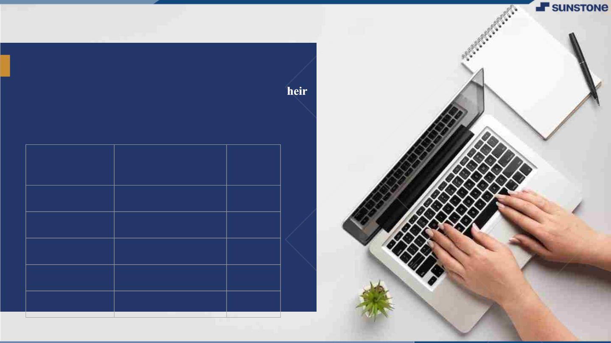
GROCERY DELIVERY WEBSITE
▪ A grocery delivery service is a platform through
which groceries can be delivered to customers at t
homes or a central pickup location. With grocery
delivery services, you can place orders and make
payments for various items online.
LMS
Name
Batch
Username
2115a917
2115a923
2115a926
2115a927
DHARANI.R
HARINI.B
JANANI.G
JANANI.G
A9
A9
A9
A9

Slide 3
errormiddleware.js
const notFound = (req, res, next) => {
const error = new Error(`Not Found - ${req.originalUrl}`)
res.status(404)
next(error)
}
const errorHandler = (err, req, res, next) => {
const statusCode = res.statusCode === 200 ? 500 : res.statusCode
res.status(statusCode)
res.json({
message: err.message,
stack: process.env.NODE_ENV === 'production' ? null : err.stack,
})
}
export { notFound, errorHandler }

Slide 4
MODELS: ordermodel
import mongoose from 'mongoose’ const orderSchema = mongoose.Schema(
{
user: {
type: mongoose.Schema.Types.ObjectId,
required: true,
ref: 'User',
},
orderItems: [
{
name: { type: String, required: true },
qty: { type: Number, required: true },
image: { type: String, required: true },
price: { type: Number, required: true },
_id: {
type: mongoose.Schema.Types.ObjectId,
required: true,
ref: 'Product',
},}, ],

Slide 5
shippingAddress: {
address: { type: String, required: true },
city: { type: String, required: true },
postalCode: { type: String, required: true },
state: { type: String, required: true },
},
paymentResult: {
id: { type: String },
status: { type: String },
update_time: { type: String },
email_address: { type: String },
},
taxPrice: {
type: Number,
required: true,
default: 0.0, },
shippingPrice: {
type: Number,
required: true,
default: 0.0,
},
totalPrice: {
type: Number,
required: true,
default: 0.0,
},},

Slide 6
{
timestamps: true,
}
)
const Order = mongoose.model('Order', orderSchema)
export default Order
Productmodel.js
import mongoose from 'mongoose';
const productSchema = new mongoose.Schema(
{
name: { type: String, required: true, unique: true },
image: { type: String, required: true },
tags: { type: Array, required: true },
desc: { type: String, required: true },
price: { type: Number, required: true },
stock: { type: Number, required: true },
},
{
timestamps: true,
}
);
const Product = mongoose.model('Product', productSchema);
export default Product;

Slide 7
Usermodels.js
import mongoose from 'mongoose';
const userSchema = new mongoose.Schema(
{
name: { type: String, required: true },
status: { type: String, default: 'member' },
email: { type: String, required: true, unique: true },
password: { type: String, required: true },
},
{
timestamps: true,
}
);
const User = mongoose.model('User', userSchema);
export default User;

Slide 8
ROUTERS: orderrouters.js
import express from 'express';
import expressAsyncHandler from 'express-async-handler';
import Order from '../models/orderModel.js';
import Stripe from 'stripe'
import { isAdmin, isAuth } from '../utils/utils.js';
import data from '../data.js';
const stripe = new Stripe('sk_test_51HdgOmBXsMDmZZcdkDscGgFvkT269F7zfqulQzLTm8zt1tOwaneYmvdCVLJ0ZXyoJbyqR6RXifM4YhsCjZpHKY5j00XoAcKnhg');
const orderRouter = express.Router();
orderRouter.post(
'/payment',
expressAsyncHandler(async (req, res) => {
const total = req.body.total;
const paymentIntent = await stripe.paymentIntents.create({
amount: total * 100,
currency: 'usd'
})
res.status(201).send({
clientSecret: paymentIntent.client_secret
}) }))

Slide 9
orderRouter.post(
'/create', isAuth,
expressAsyncHandler(async (req, res) => {
const {
orderItems,
shippingAddress,
paymentMethod,
itemsPrice,
taxPrice,
shippingPrice,
totalPrice,
} = req.body
if (orderItems && orderItems.length === 0) {
res.status(400)
throw new Error('No order items')
return
} else {
const order = new Order({
orderItems,
user: req.user._id,
shippingAddress,
paymentMethod,
itemsPrice,
taxPrice,
shippingPrice,
totalPrice,
})

Slide 10
const createdOrder = await order.save().then(() => {
})
.catch((error) => {
//When there are errors We handle them here res.status(404)
throw new Error('Order not found')
});
res.status(201).json({createdOrder})
}
})
)
orderRouter.get(
'/orderId/:id',
expressAsyncHandler(async (req, res) => {
const order = await Order.findById(req.params.id).populate(
'user',
'name email'
)
if (order) {
res.json(order)
} else {
res.status(404)
throw new Error('Order not found')
}
})
);

Slide 11
orderRouter.get(
'/myorders', isAuth,
expressAsyncHandler(async (req, res) => {
const orders = await Order.find({ user: req.user._id })
res.json(orders)
})
)
orderRouter.get(
'/all',
isAuth,
isAdmin,
expressAsyncHandler(async (req, res) => {
const orders = await Order.find({})
res.json(orders)
})
)
orderRouter.get(
'/seed',
expressAsyncHandler(async (req, res) => {
await Order.remove({});
const createdProducts = await Order.insertMany(data.orders);
res.send({createdProducts});
})
);
export default orderRouter;

Slide 12
Productrouters.js
import express from 'express';
import expressAsyncHandler from 'express-async-handler';
import data from '../data.js';
import Product from '../models/productModel.js';
const productRouter = express.Router();
productRouter.get(
'/',
expressAsyncHandler(async (req, res) => {
const products = await Product.find({});
res.send(products);
})
);
productRouter.get(
'/seed',
expressAsyncHandler(async (req, res) => {
await Product.remove({});
const createdProducts = await Product.insertMany(data.products);
res.send({ createdProducts });
})
);

Slide 13
productRouter.post(
'/filter',
expressAsyncHandler(async (req, res) => {
const {filter} = req.body
const products = await Product.find({tags: filter })
res.json(products)
})
)
productRouter.get(
'/productId/:id',
expressAsyncHandler(async (req, res) => {
const product = await Product.findById(req.params.id);
if (product) {
res.send(product);
} else {
res.status(404)
throw new Error('Product Not found')
}
})
);
export default productRouter;

Slide 14
Userrouters.js
import express from 'express';
import expressAsyncHandler from 'express-async-handler';
import data from '../data.js';
import User from '../models/userModel.js';
import { isAdmin, isAuth, generateToken } from '../utils/utils.js';
import bcrypt from 'bcryptjs'
const userRouter = express.Router();
userRouter.get(
'/seed',
expressAsyncHandler(async (req, res) => {
await User.remove({});
const createdUsers = await User.insertMany(data.users);
res.json({ createdUsers });
})
);
userRouter.post('/login', expressAsyncHandler(async (req,res) => {
const {email, password} = req.body
const user = await User.findOne({email})
if (user && (await bcrypt.compare(password, user.password)) ) {
res.json({
_id: user._id,
name: user.name,
email: user.email,
status: user.status,

Slide 15
token: generateToken(user._id),
})
} else {
res.status(401)
throw new Error('Invalid email or password')
}
}))
userRouter.post('/register', expressAsyncHandler(async (req, res) => {
const {name, email, password} = req.body
const userExists = await User.findOne({email})
if (userExists) {
res.status(400)
throw new Error('User already exists')
}
const user = await User.create({
name, email, password
})
if (user) {
res.status(201).json({
_id: user._id,
name: user.name,
email: user.email,
status: user.status,
token: generateToken(user._id)
})
} else {
res.status(400)

Slide 16
throw new Error('Invalid user data')
}
}
userRouter.get('/id/:id', expressAsyncHandler(async (req, res) => {
const user = await User.findById(req.params.id)
if (user) {
res.json(user)
} else {
res.status(404)
throw new Error('User not found')
}
}))
userRouter.get(
'/',
isAuth,
isAdmin,
expressAsyncHandler(async (req, res) => {
const users = await User.find({});
res.json(users);
})
);
export default userRouter;

Slide 17
Db.js
import mongoose from 'mongoose'
import colors from 'colors'
const connectDB = async () => {
try {
const conn = await mongoose.connect(process.env.MONGODB_URL || 'mongodb://localhost/eccomerce', {
useUnifiedTopology: true,
useNewUrlParser: true,
useCreateIndex: true,
})
console.log(`MongoDB Connected: ${conn.connection.host}`.cyan.underline)
} catch (error) {
console.error(`Error: ${error.message}`.red.underline.bold)
process.exit(1)
}
}
export default connectDB

Slide 18
Seeder.js
import mongoose from 'mongoose'
import dotenv from 'dotenv'
import colors from 'colors'
import users from './data/users.js'
import products from './data/products.js'
import User from '../models/userModel.js'
import Product from '../models/productModel.js'
import Order from '../models/orderModel.js'
import connectDB from './db.js'
dotenv.config()
connectDB()
const importData = async () => {
try {
await Order.deleteMany()
await Product.deleteMany()
await User.deleteMany()
const createdUsers = await User.insertMany(users)
const adminUser = createdUsers[0]._id
const sampleProducts = products.map((product) => {
return { ...product, user: adminUser }
})
await Product.insertMany(sampleProducts
console.log('Data Imported!'.green.inverse)

Slide 19
process.exit()
} catch (error) {
console.error(`${error}`.red.inverse)
process.exit(1)
}
}
const destroyData = async () => {
try {
await Order.deleteMany()
await Product.deleteMany()
await User.deleteMany()
console.log('Data Destroyed!'.red.inverse)
process.exit()
} catch (error) {
console.error(`${error}`.red.inverse)
process.exit(1)
}
}
if (process.argv[2] === '-d') {
destroyData()
} else {
importData()
}

Slide 20
Utils.js
import jwt from "jsonwebtoken";
export const generateToken = (user) => {
return jwt.sign(
{
_id: user._id,
name: user.name,
email: user.email,
status: user.status,
},
process.env.JWT_SECRET || "somethingsecret",
{
expiresIn: "30d",
});};
export const isAuth = (req, res, next) => {
const authorization = req.headers.authorization;
if (authorization) {
const token = authorization.slice(7, authorization.length); // Bearer XXXXXX
jwt.verify(
token,
process.env.JWT_SECRET || "somethingsecret",
(err, decode) => {
if (err) {
console.error(err);

Slide 21
res.status(401);
throw new Error("Not authorized, token failed");
} else {
req.user = decode;
next();
}} );
} else {
res.status(401);
throw new Error("Not authorized, no token");
}
};
export const isAdmin = (req, res, next) => {
if (req.user && req.status === 'admin') {
next();
} else {
res.status(401);
throw new Error("Not authorized as an admin");
}
};

Slide 22
Server.js
import express from 'express';
import dotenv from 'dotenv';
import morgan from 'morgan';
import userRoutes from './routers/userRoutes.js'
import orderRoutes from './routers/orderRoutes.js'
import productRoutes from './routers/productRoutes.js'
import {notFound, errorHandler} from './middleware/errorMiddleware.js'
import connectDB from './utils/db.js';
import cors from 'cors'
dotenv.config();
const app = express();
app.use(cors())
app.use(express.json());
app.use(express.urlencoded({ extended: true }));
connectDB()
if (process.env.NODE_ENV === 'development') {
app.use(morgan('dev'))
}
app.use('/api/products', productRoutes)
app.use('/api/users', userRoutes)
app.use('/api/order', orderRoutes)
app.get('/', (req, res) => {
res.send('Server is ready');

Slide 23
});
app.use(notFound)
app.use(errorHandler)
const PORT = process.env.PORT || 5000;
app.listen(PORT, () => {
console.log(
`Server running in ${process.env.NODE_ENV} mode on port ${PORT}`
)});

Slide 24
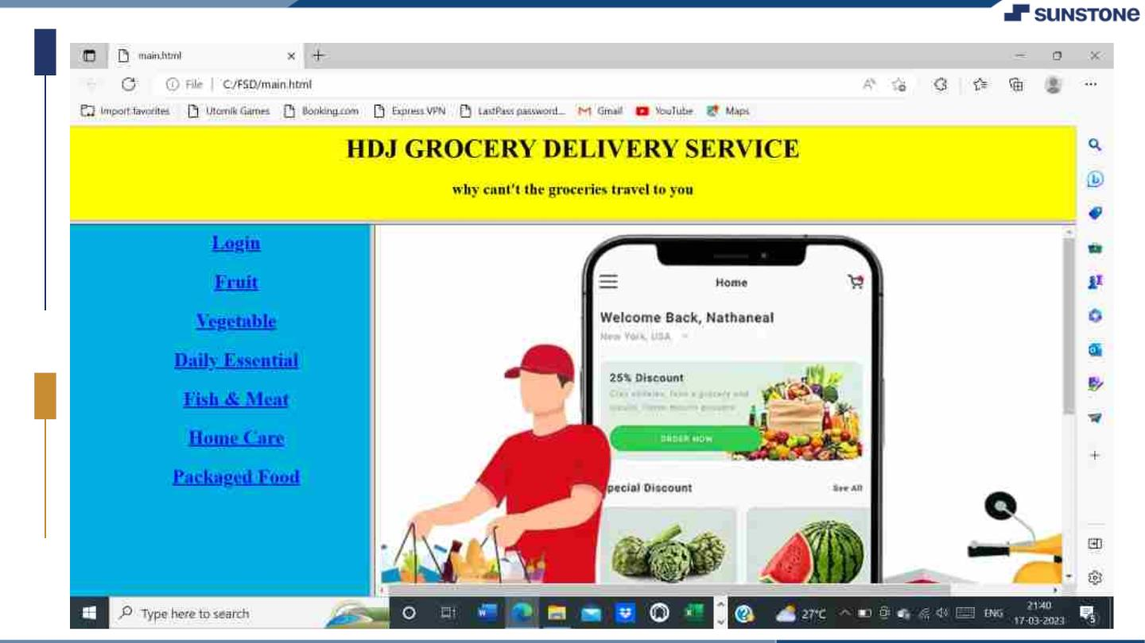

Slide 25
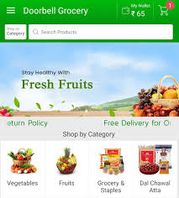

Slide 26

Submission Github
https://github.com/DHARU301/groceryjs.git

Slide 27


